Slide 1
A Quantification of Greenhouse Gas Emissions from Increased Travel to the Tahoe Reno Industrial Center
David McGraw and Brooke Stathis
Desert Research Institute
March, 2020

Slide 2
Purpose
Understand existing pollutant and energy consumption in the Sparks metro area
Evaluate the effect of increased growth and additional highways on emissions and energy consumption

Slide 3
Regional Inventory
Used EPA model MOVES
MOVES is a commonly-used platform that implements the EPA's Office of Transportation and Air Quality emission and emission factor estimation tools for mobile sources.

Slide 4
Regional Inventory Results
Year | HC (tons/d) | CO (tons/d) | CO2 Atm. (tons/d) | CO2 Eq. (tons/d) | PM2.5 (tons/d) | CH4 (tons/d) | TEC (tons/d) | NOx (tons/d)
2015 | 1.18 | 29 | 3,771 | 3,773 | 0.29 | 0.06 | 4,4758 | 9.16
2017 | 1.17 | 36 | 4,664 | 4,666 | 0.15 | 0.08 | 5,5404 | 8.49

Slide 5
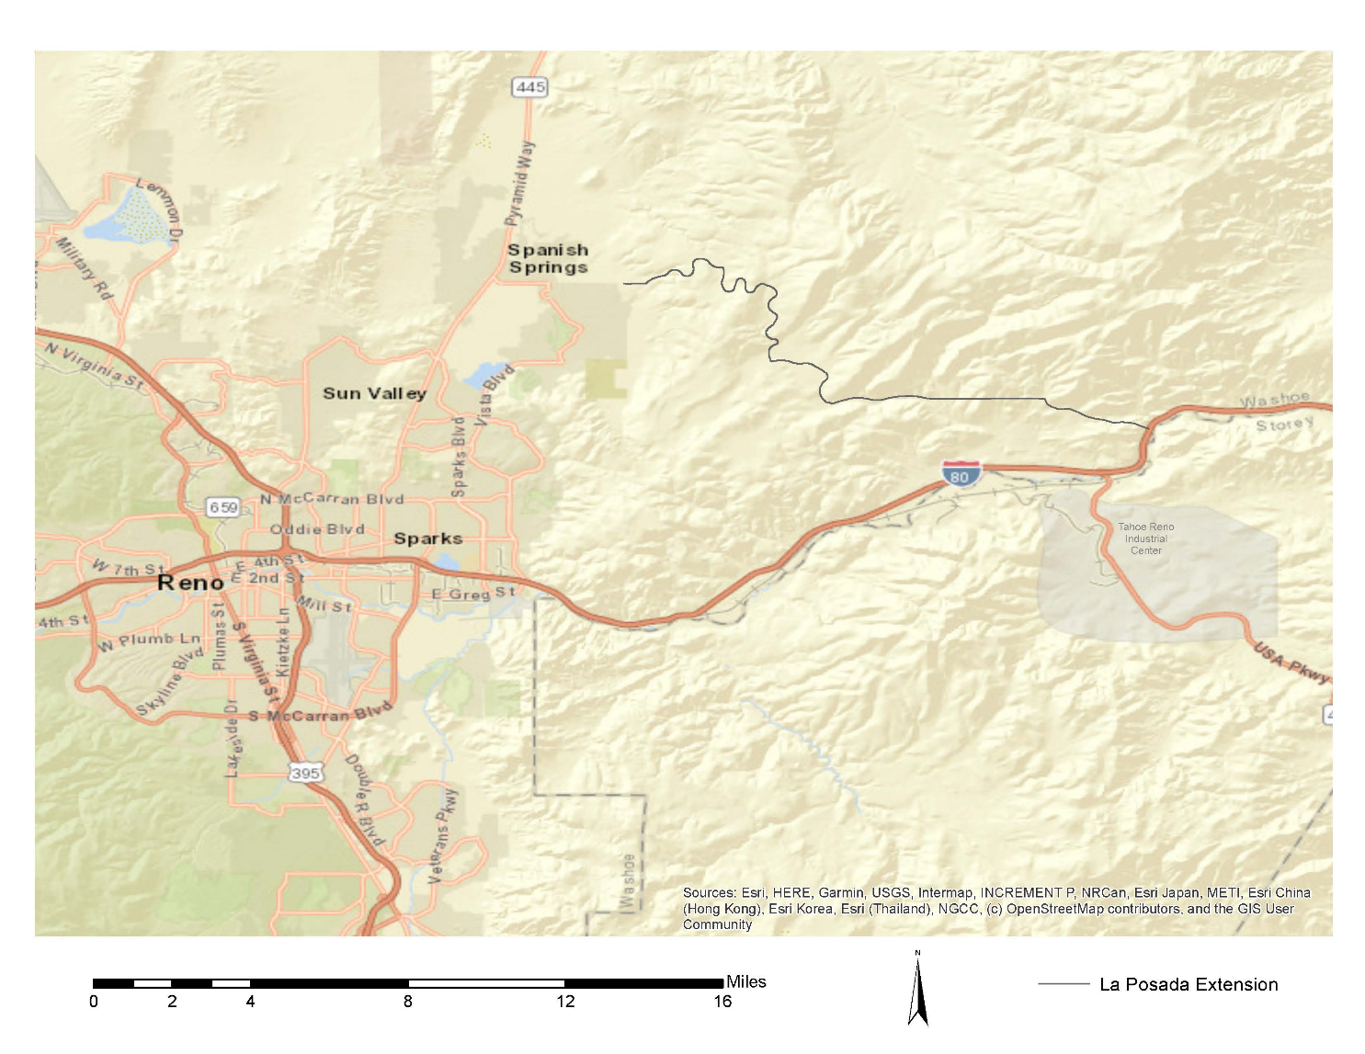
Corridor-specific Inventory
Developed a pollutant inventory for three corridors
Pyramid Way
Interstate 80
Proposed new highway (La Posada Extension)
Used traffic simulation tools (SUMO) to estimate emissions from observed traffic patterns and vehicle distributions
La Posada
Pyramid
I-80

Slide 6
Corridor-specific Inventory
Evaluated current traffic on Pyramid Way and Interstate 80
Evaluated effect of diverting or increasing traffic to La Posada
10 simulations
4 categories
Baseline
Divert traffic from Pyramid to La Posada
Increase traffic on Pyramid and I-80
Increase traffic on La Posada

Slide 7
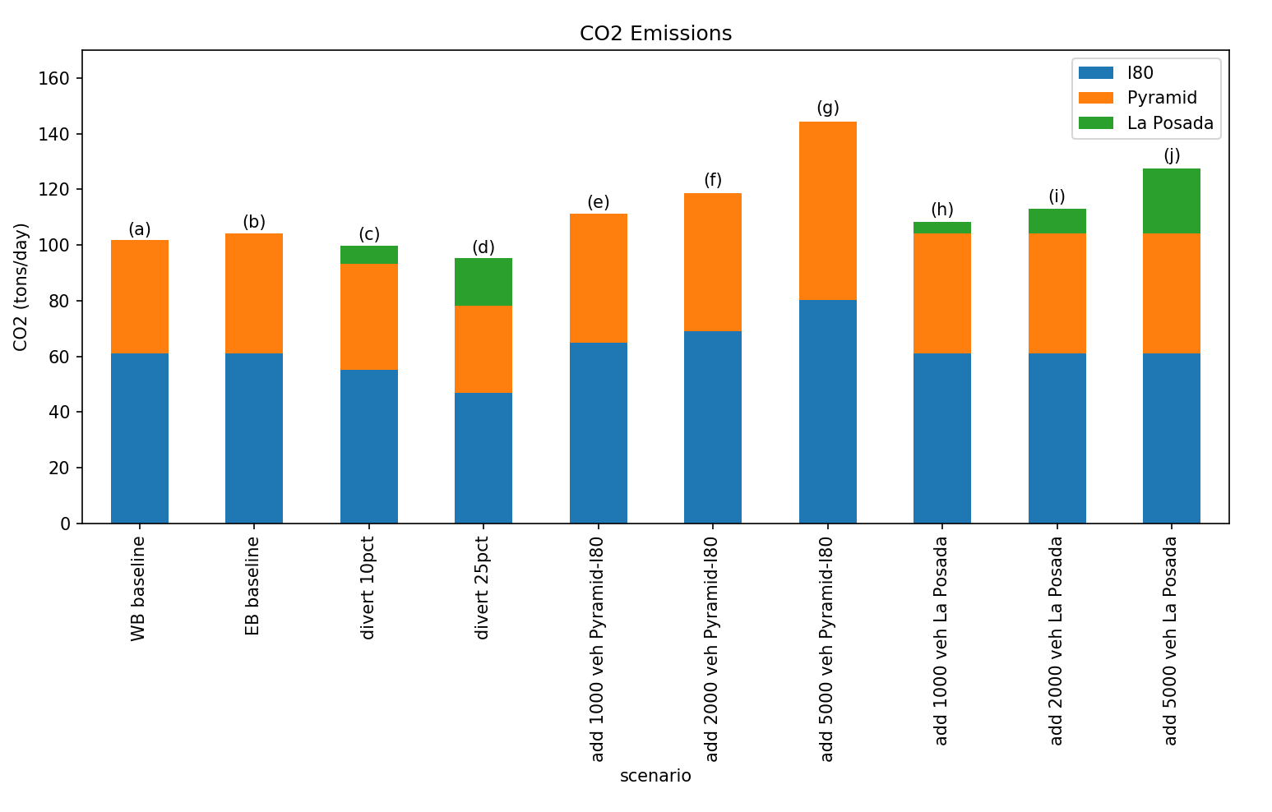
La Posada
Pyramid
I-80

Slide 8
Baseline: 104
Add 5000 veh to Pyramid/I80: 144
64
80

Slide 9
Baseline: 104
Add 5000 veh to Pyramid/I80: 144
Add 5000 veh to La Posada: 127
23
43
61

Slide 10
Discussion
Emissions from Pyramid Way are significant
Due to congestion, which causes stop-and-go traffic
Diverting traffic away from Pyramid Way can reduce total emissions
La Posada extension, as an alternative to Pyramid-I80, is a more-efficient path from Sparks to TRIC because:
Free-flowing traffic emits less GHG than stop-and-go
Shorter distance

Slide 11
Extra slides

Slide 12
Total CO2 Baseline: 104
43
61

Slide 13
Baseline: 104
Divert 10% to La Posada: 99
6
43
38
61
55

Slide 14
Baseline: 104
Divert 25% to La Posada: 95
17
43
31
61
47

Slide 15
Baseline: 104
Add 1000 veh to Pyramid/I80: 111
46
65

Slide 16
Baseline: 104
Add 1000 veh to Pyramid/I80: 111
Add 1000 veh to La Posada: 107
4
43
61

Slide 17
Baseline: 104
Add 2000 veh to Pyramid/I80: 119
50
69

Slide 18
Baseline: 104
Add 2000 veh to Pyramid/I80: 119
Add 2000 veh to La Posada: 113
9
43
61

